Slide 1

Test Launch Findings Presentation

Slide 2
In summary 72% (36/50 customers) of participants ranked the experience positive [Rating 4 (20) , Rating 5 (16)] , indicating the need for further improvement
Test Launch and survey were conducted with the tablet ordering system
50 customers participated in the pre-launch survey (digitally sent)
A total of 16 survey questions were asked
Summary ( Milestone Test Launch)

Slide 3
In this test, we wanted to measure
Ease of Software Use (Need for Instructions)
Customer UX (User Experience)
Order Processing Time
Order Accuracy (Comments)
Type of Order (Drinks/Appetizers/Dinner/Desert)
Order Delivery Time
Customer acquisition (Newsletter / Birthday Club)
Technical Issues encountered
Overview

Slide 4
Findings

Slide 5
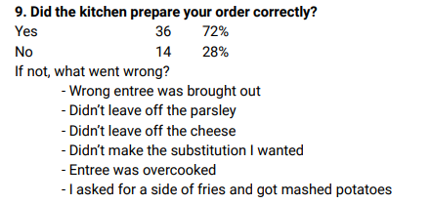
Order accuracy was 72% in the test Launch
Increase order accuracy with a target of 100% , by ensuring ease of order process and optimizing the terminal so kitchen can view customer comments on orders ( Exceptions/ substitutions)
Next Steps

Slide 6
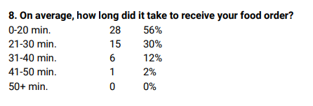
30 % of orders were delivered in 21-30 minutes ( Train staff to process orders faster through the terminal / Hire more kitchen staff)
Eliminate delays more than 30 minutes (6 clients) explore delay issues
1 Customer waited more than 41 minutes (Eliminate these delays, Give Free desert / Coupons in extreme delays)
Next Steps

